Slide 1
TIME VALUE
OF MONEY

Slide 2
Team Members
Aima Sibtain
Maheen Akhtar Khan
411885
429419
Hadia Ali
Aimen Munawar
410865
415867

Slide 3
TABLE OF CONTENTS
01
02
03
04
05
06
07
Introduction
Interest
Cash Flow & Cash Flow Diagram
Payback Analysis
Present Worth Analysis
Rate of Return Analysis
Future Worth Analysis

Slide 4
INTRODUCTION

Slide 5
How are they related?
Engineering Economics
The process of making decisions on engineering projects based on their financial and economic consequences.
Time Value of Money
The process of making decisions on engineering projects based on their financial and economic consequences.

Slide 6
Simple Interest (SI)
Interest is calculated only on the original principal amount.
It exhibits a linear growth pattern.
Interest = P x i x n
Future Amount = P x (1 + i x n)

Slide 7
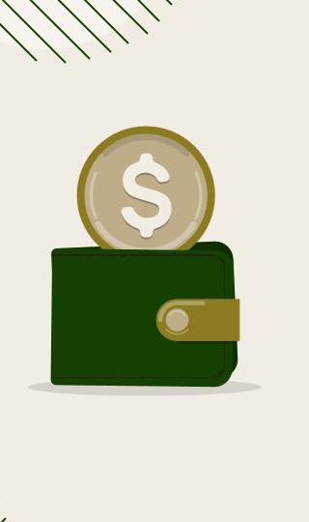
Compound Interest
Interest is calculated on the principal PLUS all previously accumulated interest.
You earn "interest on interest."
It exhibits an exponential growth pattern.

Slide 8
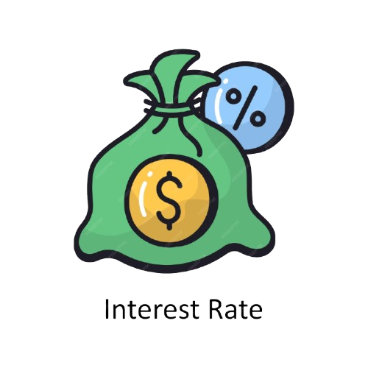
Compound Interest
Compound Interest = P x (1 + i)^{n}- P
Future Value = P x (1 + i)^{n}

Slide 9
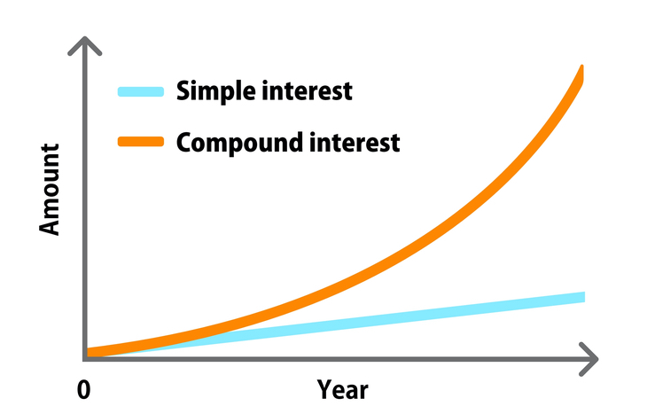
Simple vs Compound

Slide 10
Present Worth Formulas
PV of Annuity
PV of Gradient
Single Payment Present Worth

Slide 11
Future Value (FV) Formulas
FV of Annuity
FV of Gradient
Single Payment Future Worth

Slide 12
CASH FLOW ANALYSIS

Slide 13
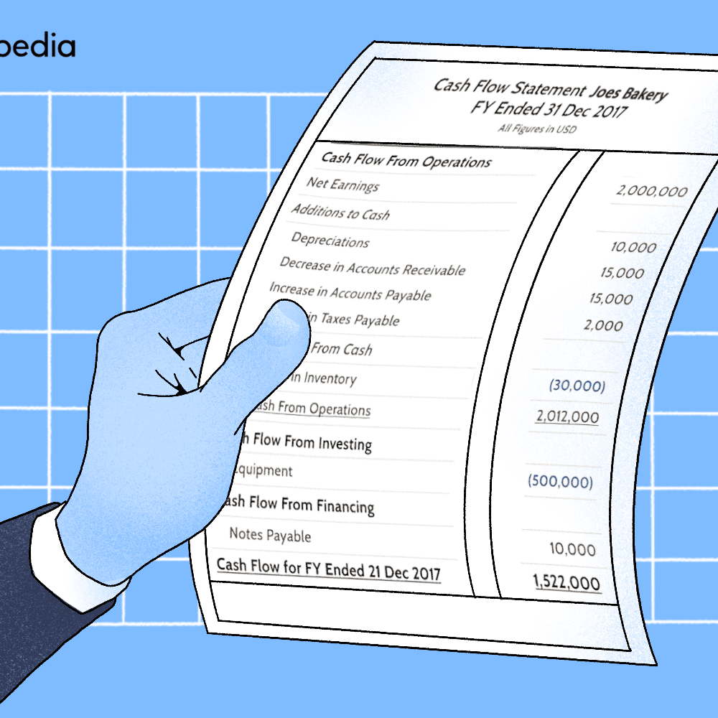
WHAT IS CASH FLOW?
Cash Flow refers to the movement of money into or out of a project over time. These flows occur at different points during the project’s life cycle. Cash flows are either:
1. Inflows, such as savings, revenues, or returns
2. Outflows, such as operating costs, maintenance expenses, and initial investments

Slide 14
TYPES OF CASH FLOWS
SINGLE PAYMENT
UNIFORM PAYMENT
This is a lump sum, essentially a one time inflow or outflow.
This is annuity, meaning the same amount is repeated yearly.
GRADIENT PAYMENT
Means increasing amounts each year.

Slide 15
SINGLE PAYMENT CASH FLOW
Future Value
Present Value
F = P(1+i)^{n}
P = F / (1+i)^{n}

Slide 16
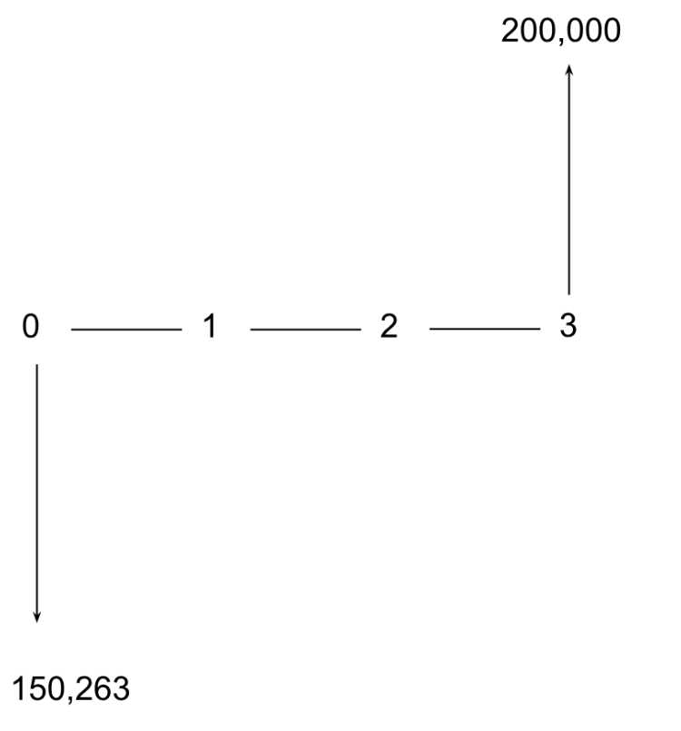
A construction firm will receive Rs. 200,000 after 3 years from a supplier contract. The discount rate is 10% per year. What is the present value of this future amount? Given F=200,000, i=0.10, n=3
P = F / (1+i)^{n} = 200,000 / 1.331= 150,263

Slide 17
UNIFORM PAYMENT CASH FLOW
Future Worth
Present Worth
F = A [((1+i)^{n} -1)/i]
P = A [((1+i)^{n} -1)/i(1+i)^{n}]

Slide 18
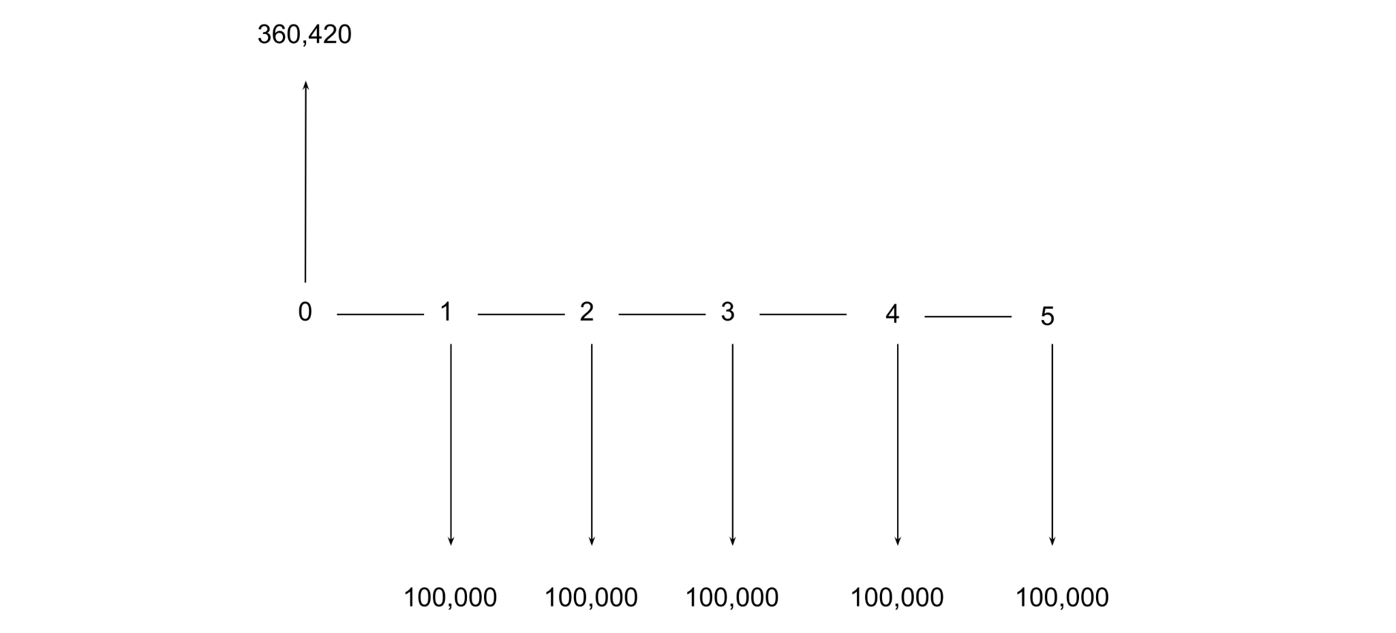
A factory pays Rs. 100,000 every year for 5 years as maintenance.
The discount rate is 12%. Find the present worth.
Given A=100,000, i=0.12,n=5
P = A [((1+i)^{n}-1)/i(1+i)^{n} ] = 100,000(0.7623/0.2115)= 360,420

Slide 19
GRADIENT SERIES

Slide 20
TYPES
ARITHMETIC
GEOMETRIC
Fixed Amount
Fixed Percentage
P=G[((1+i)^{n} -in-1)/i²(1+i)^{n}]
P = A₁{1-(1+i)^{-n} (1+f)^{n} /(i+f)}

Slide 21
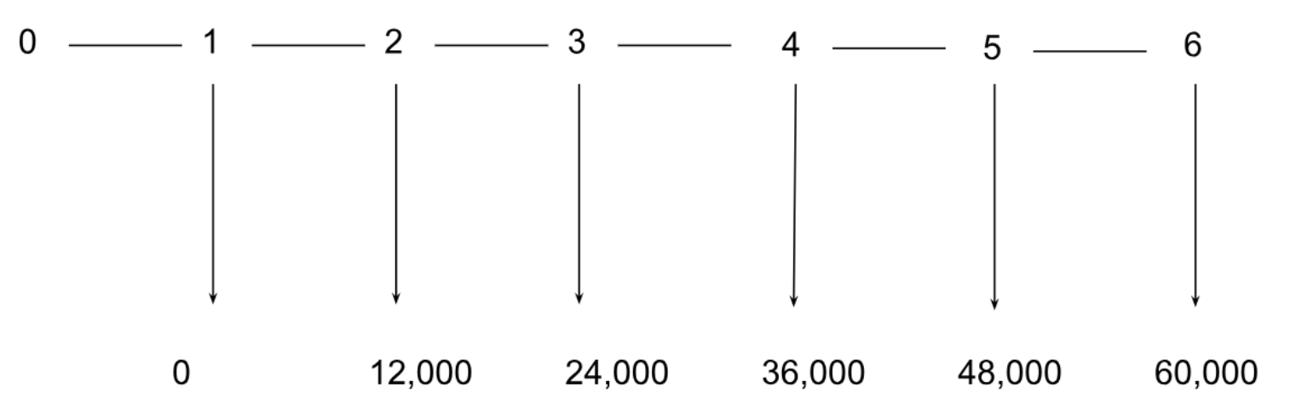
A software company expects annual maintenance expenses to start at Rs. 0 in Year 1, then increase by Rs. 12,000 every year for the next 5 years (Years 2-6). The discount rate is 9%. Find the present worth of this gradient series.
P=121,100

Slide 22
PAYBACK ANALYSIS

Slide 23
PAYBACK ANALYSIS
Concept
Formula
Payback Period=Initial Investment/Annual Cash flow
Time required to recover project cost from annual cash inflows.

Slide 24
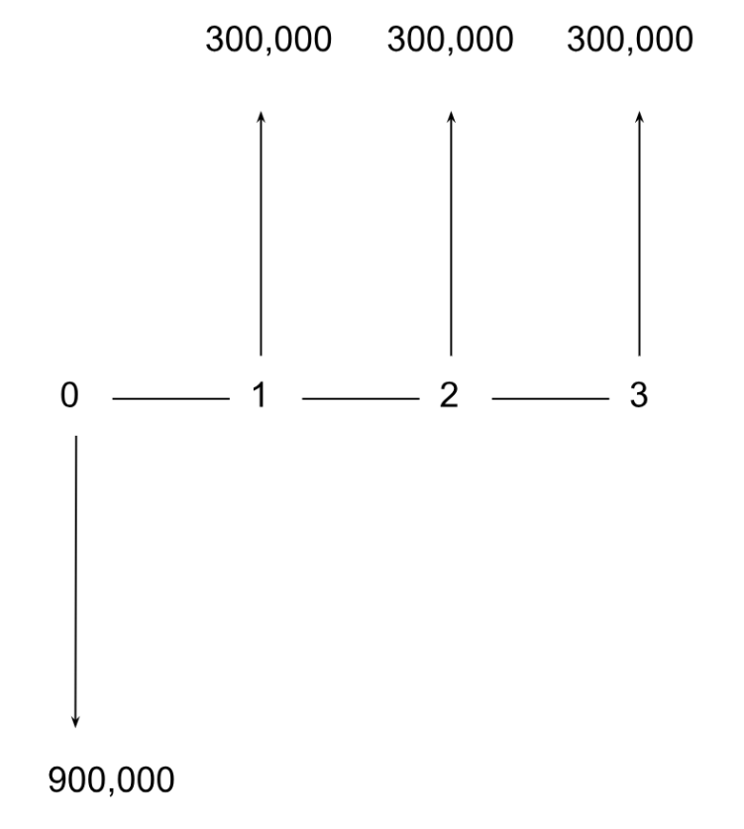
A food processing unit installs an automatic packaging system costing Rs. 900,000. Annual savings are Rs. 300,000.
Payback Period=900,000/300,000=3 years

Slide 25
PRESENT WORTH ANALYSIS

Slide 26
PRESENT WORTH ANALYSIS
Concept
Formula
P=F/(1+i)^{n}
P= A [((1+i)ⁿ-1)/i(1+i)^{n}]
Converts future money to today's value.

Slide 27
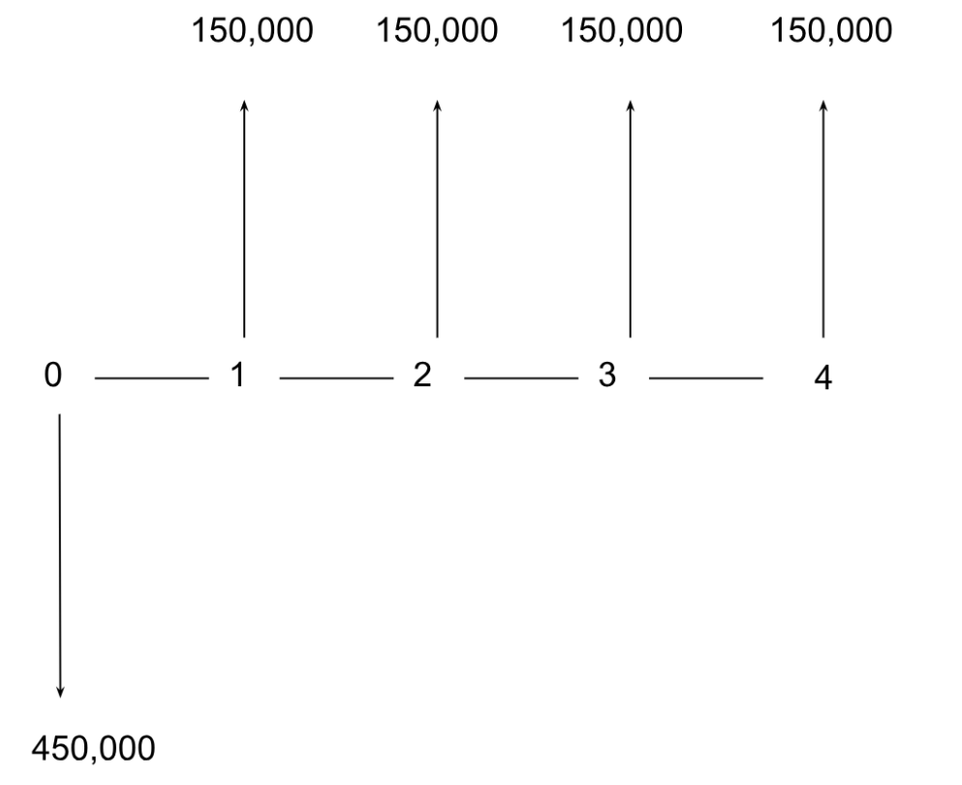
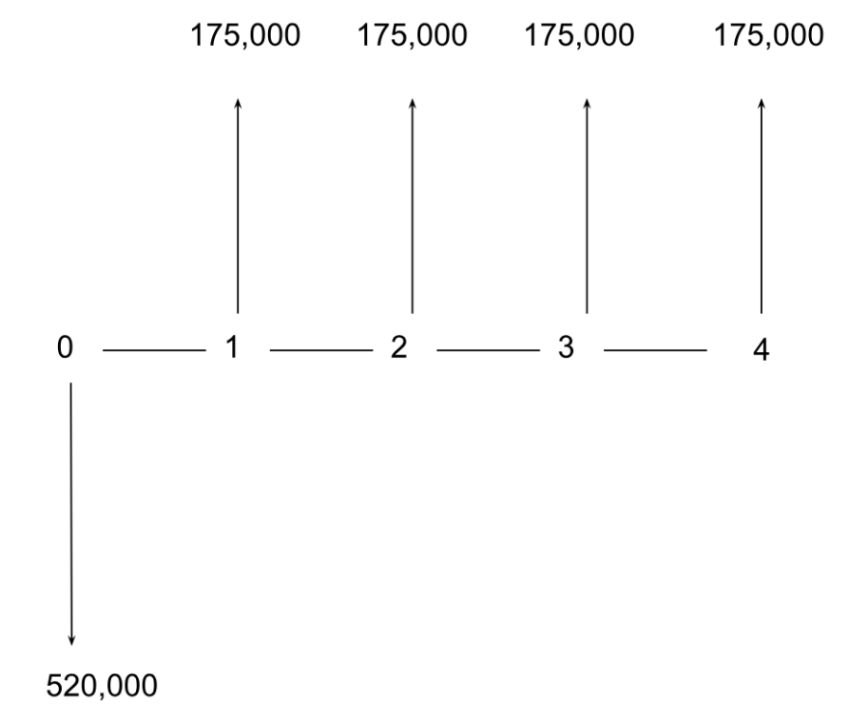
PW Result
+5,629
+11,650

Slide 28
Rate of Return
Analysis

Slide 29
Rate of Return
Concept
Formulas
Interest earned on investment
i=(F/P)^{1/n}-1
P= A [(1+i)^{n}-1 / i(1+i)^{n}]
F= A [(1+i)^{n}-1 / i]

Slide 30
Internal Rate of Return
Interest rate that makes:
Present Worth (PW) = 0
OR
Future Worth (FW) = 0
Present Value of Inflows = Present Value of Outflows

Slide 31
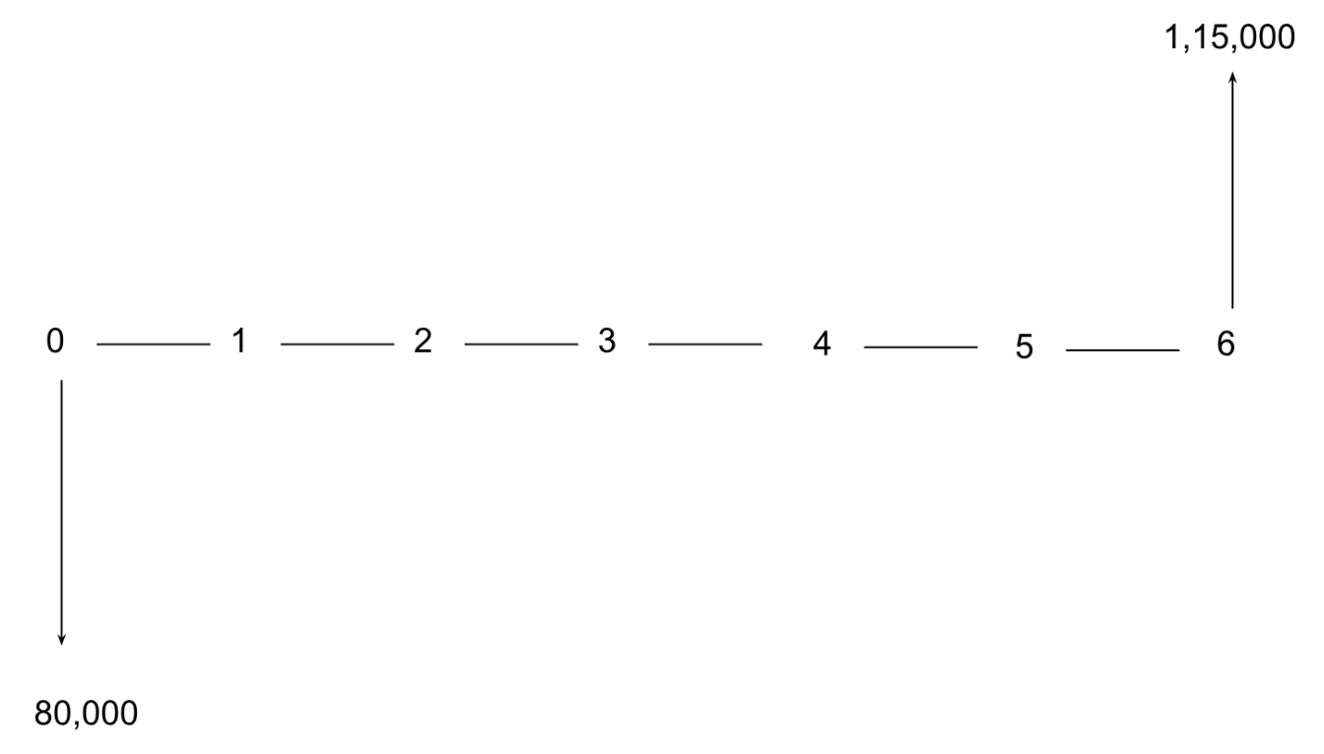
Aimen invests Rs. 80,000 in a government bond. After 6 years, she receives Rs. 1,15,000. Find the annual rate of return on her investment.
F=P (1+i)^{n} => 1 + i = (F / P)^{1/n}
1 + i = (115000 / 80000)^{⅙} = 0.0614 or 6.14% per year

Slide 32
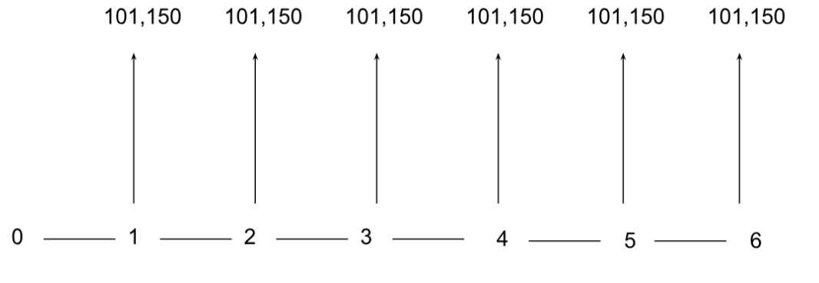
Maheen wants to create a fund for her higher studies. She needs Rs. 8,00,000 after 6 years. The bank offers 11% interest compounded annually. How much must she deposit every year (equal annual payments) to reach this amount?
A= F [i / (1+i)^{n}-1]= 88,000/0.870= 1,01,150

Slide 33
Future Worth Analysis

Slide 34
Future Worth
Concept
Formulas
Future value of cash flows
F= P(1+i)^{n}
F= A [(1+i)^{n}-1 / i]

Slide 35
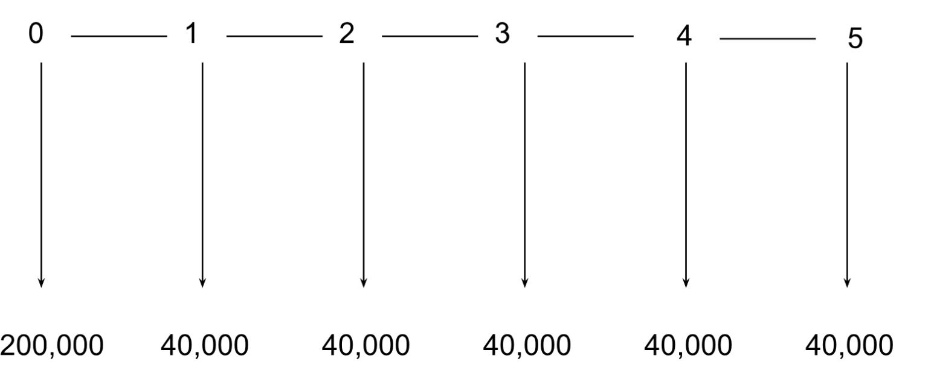
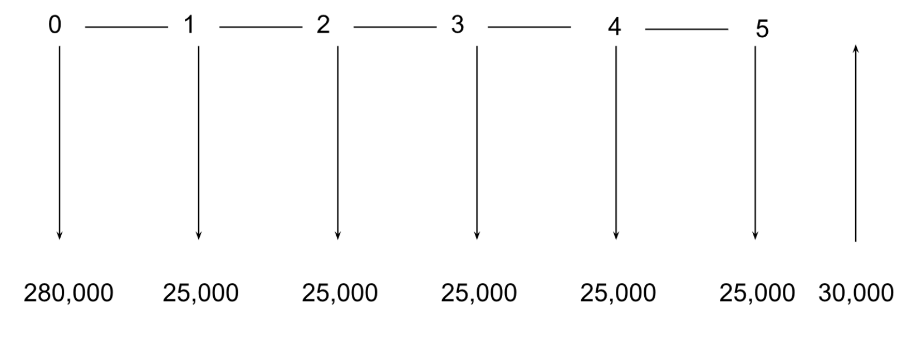
FW Result
+ 5,66,306
+5,73,570

Slide 36
Conclusion
Money's value changes with time
Enables systematic project evaluation
Guides engineering & personal finance
Ensures optimal resource use

Slide 37
THANKS!

